Slide 1

Trevor Rife
07/16/2018

Slide 2

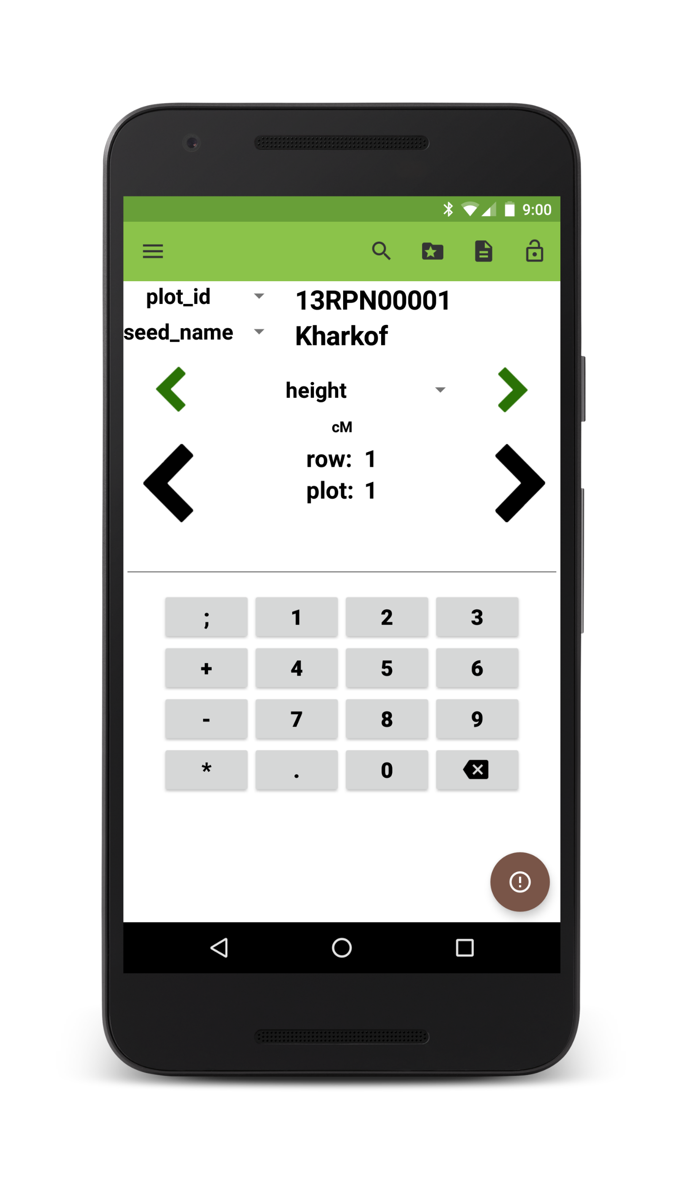
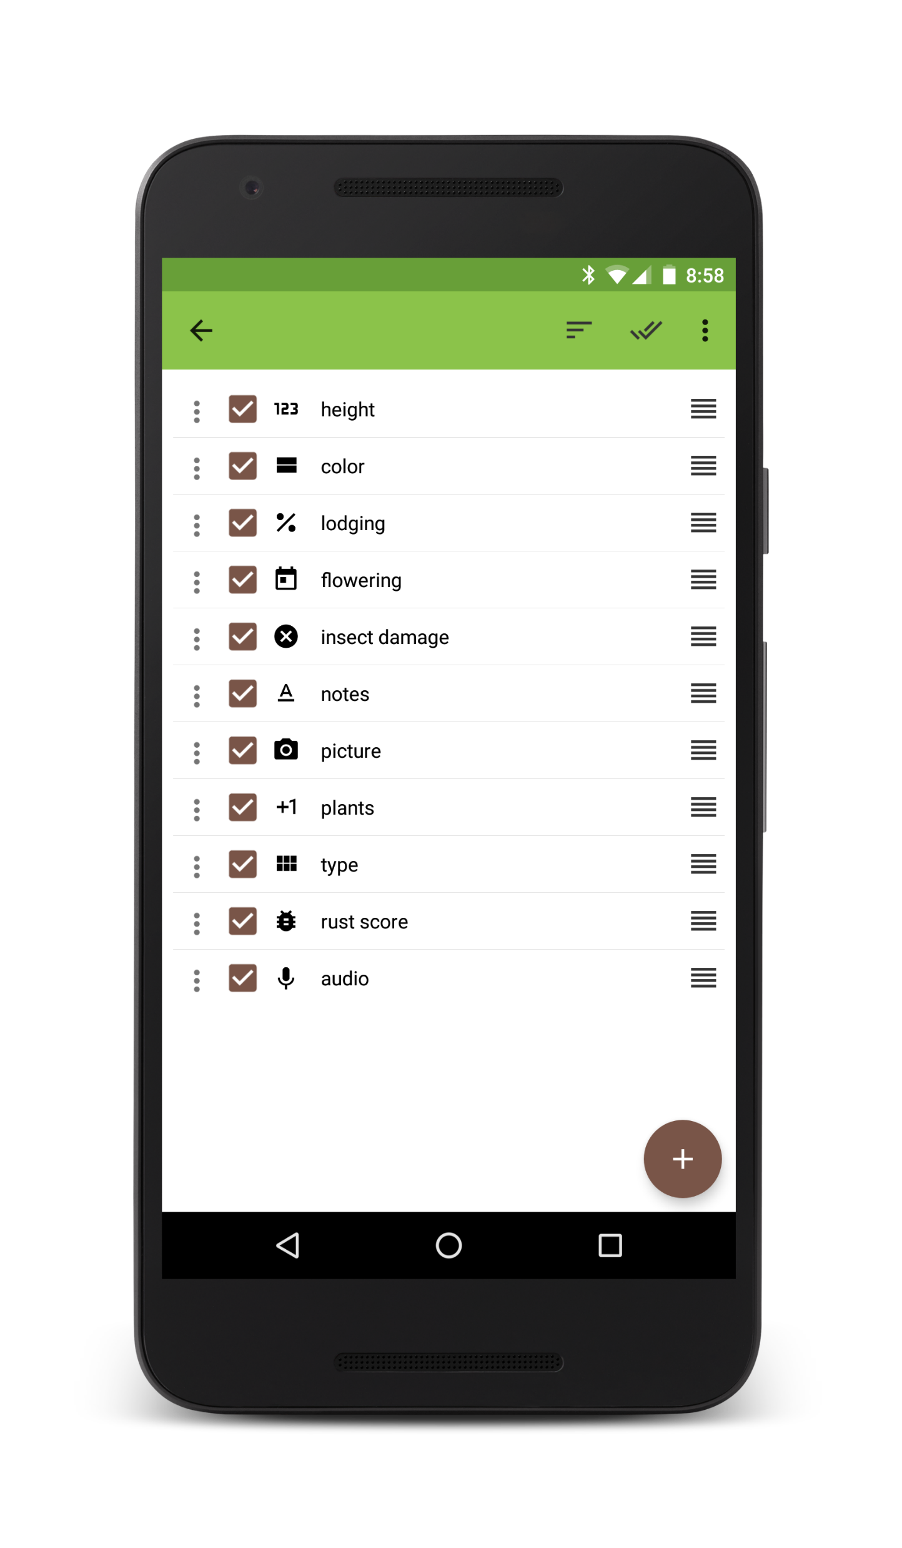
Field Book
Phenotypic data collection
Navigate between plots or traits
Extra plot information shown
Manage traits within the app
12 custom trait formats/layouts
Highly customizable
7000+ total installs

Slide 3

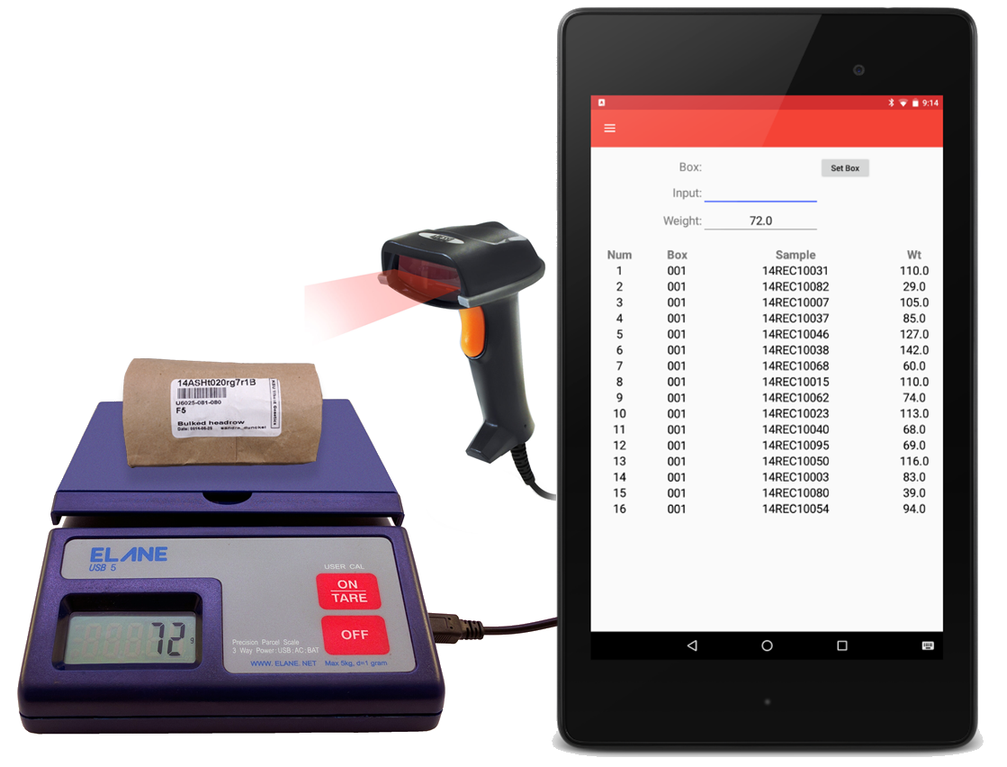
Inventory
Associate sample IDs with a specific box
Simultaneously collect sample weight
Two export formats:
CSV flat file
SQL file: deletes previous box from database and replaces

Slide 4

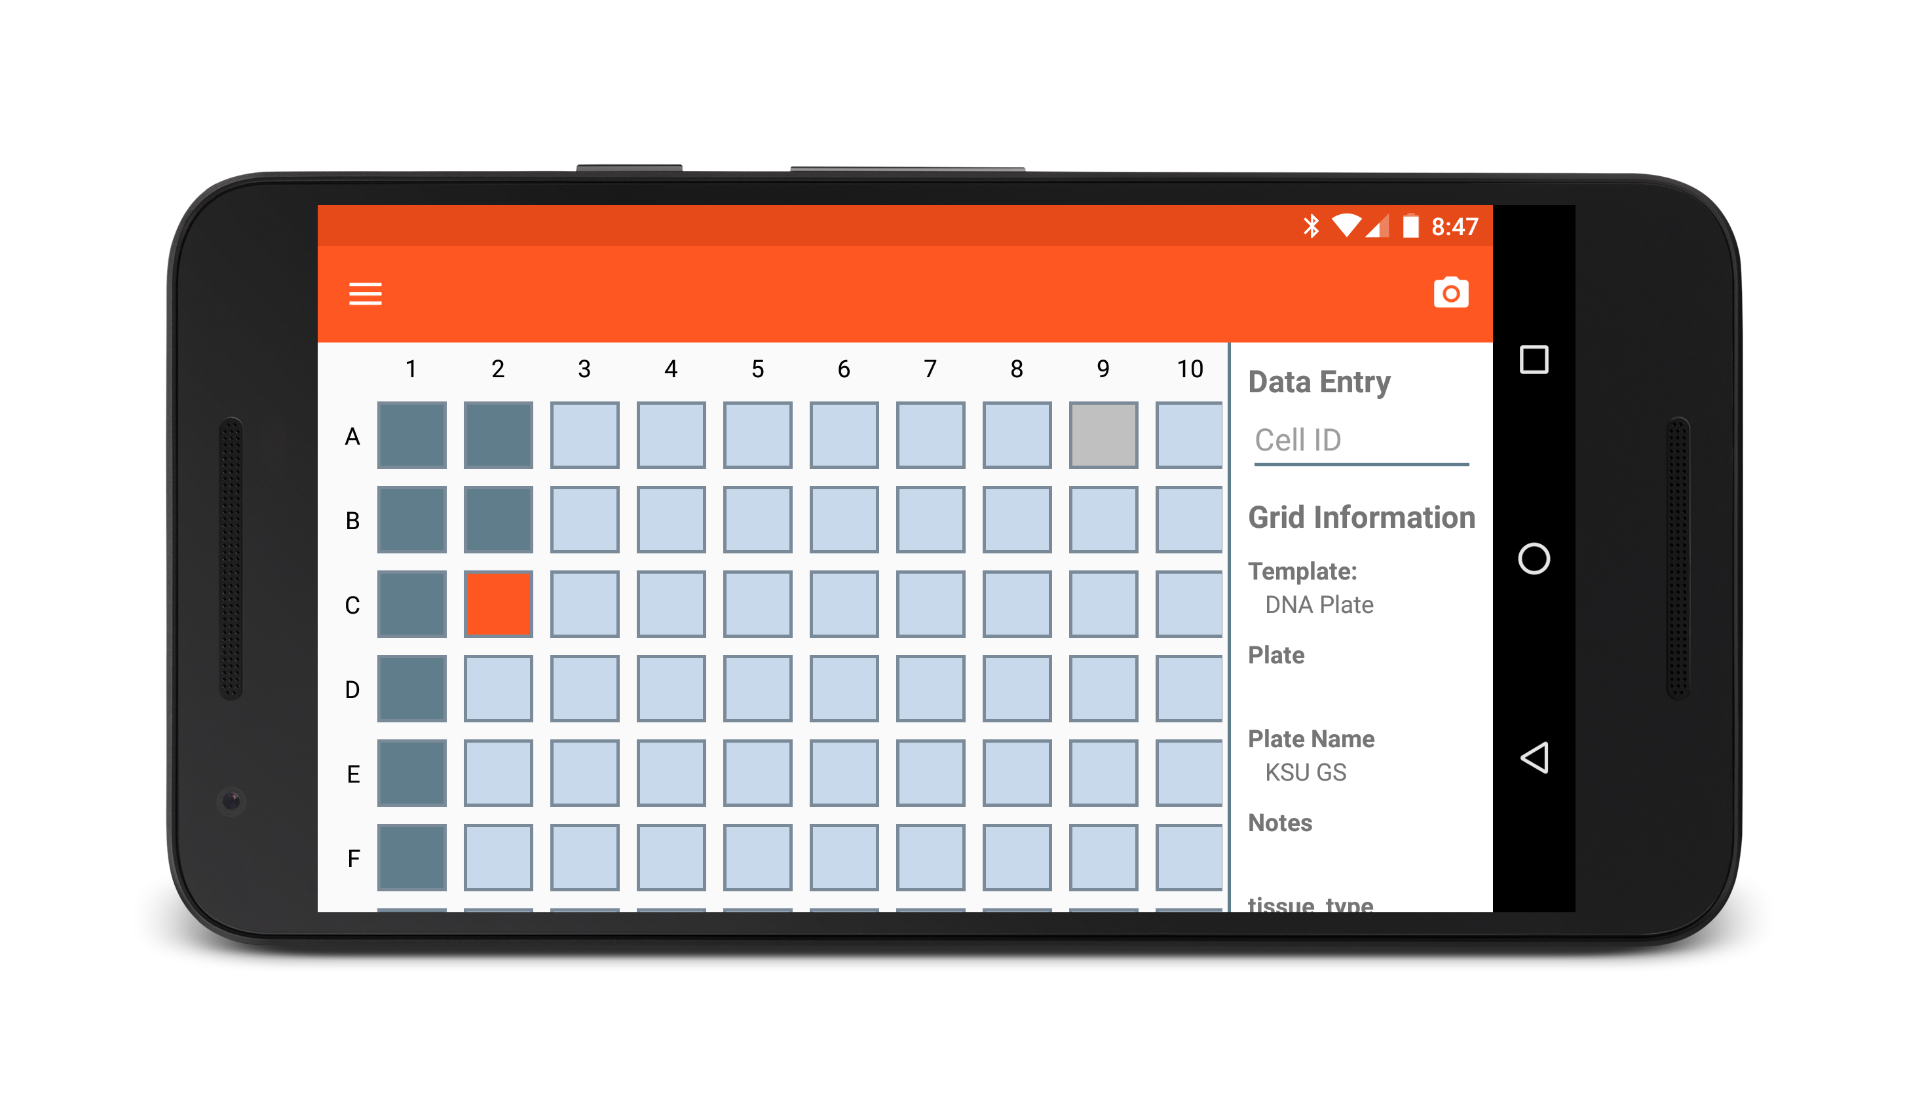
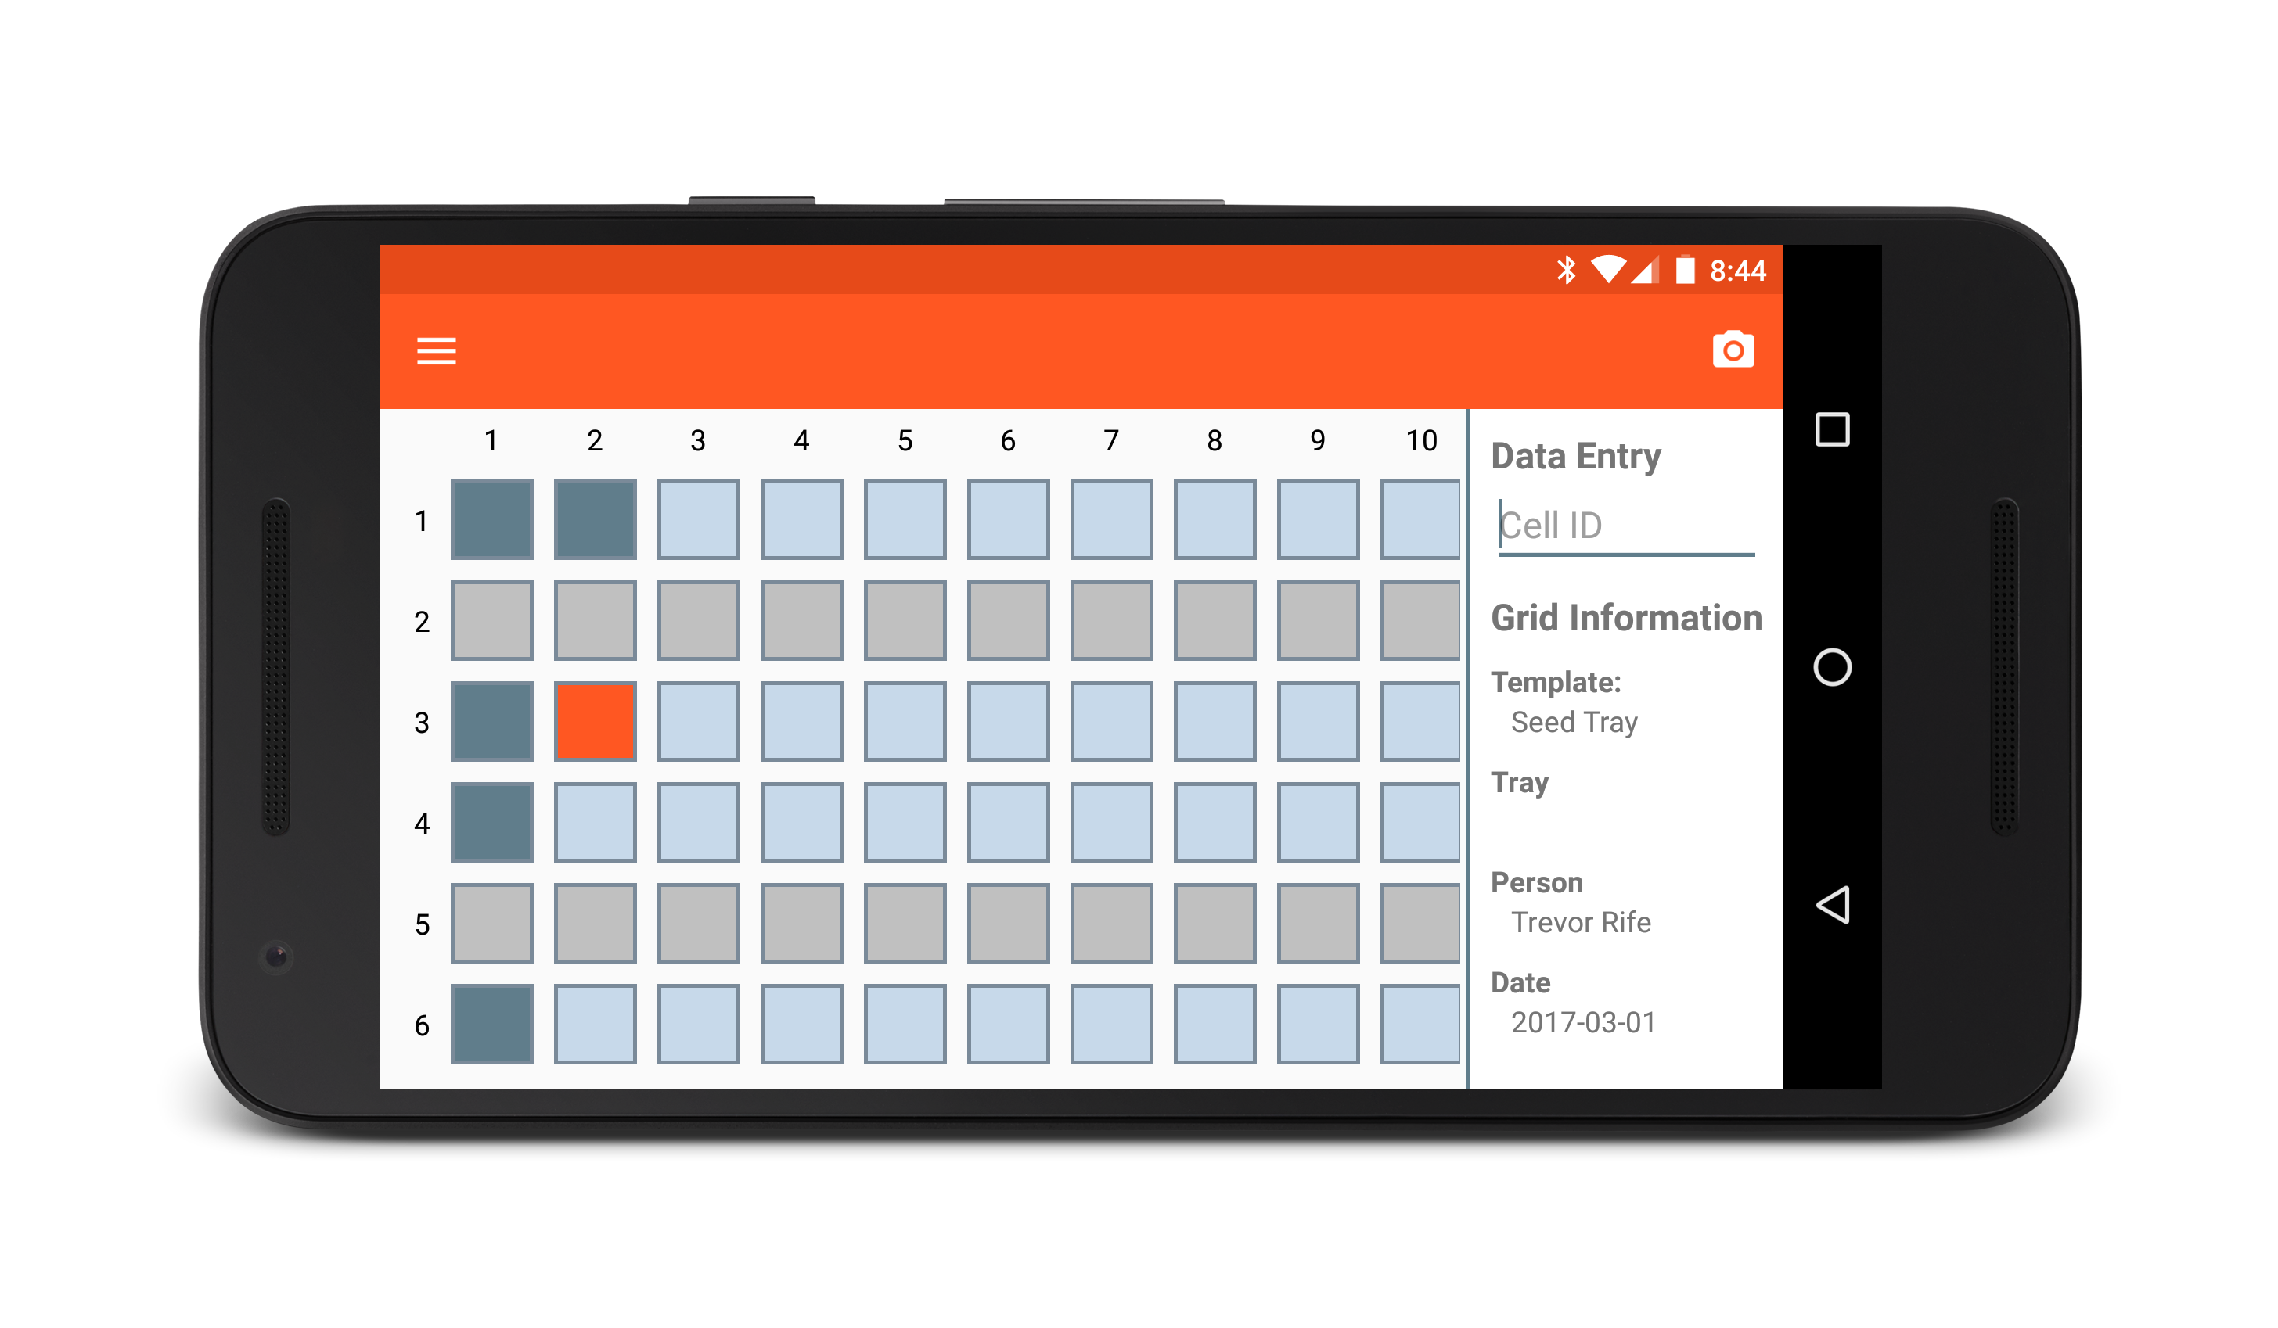
Coordinate
Organize samples in grids
Create custom templates
Exclude rows, columns
Change naming schemes
Add custom data fields
Default templates
DNA plates
Seed trays

Slide 5

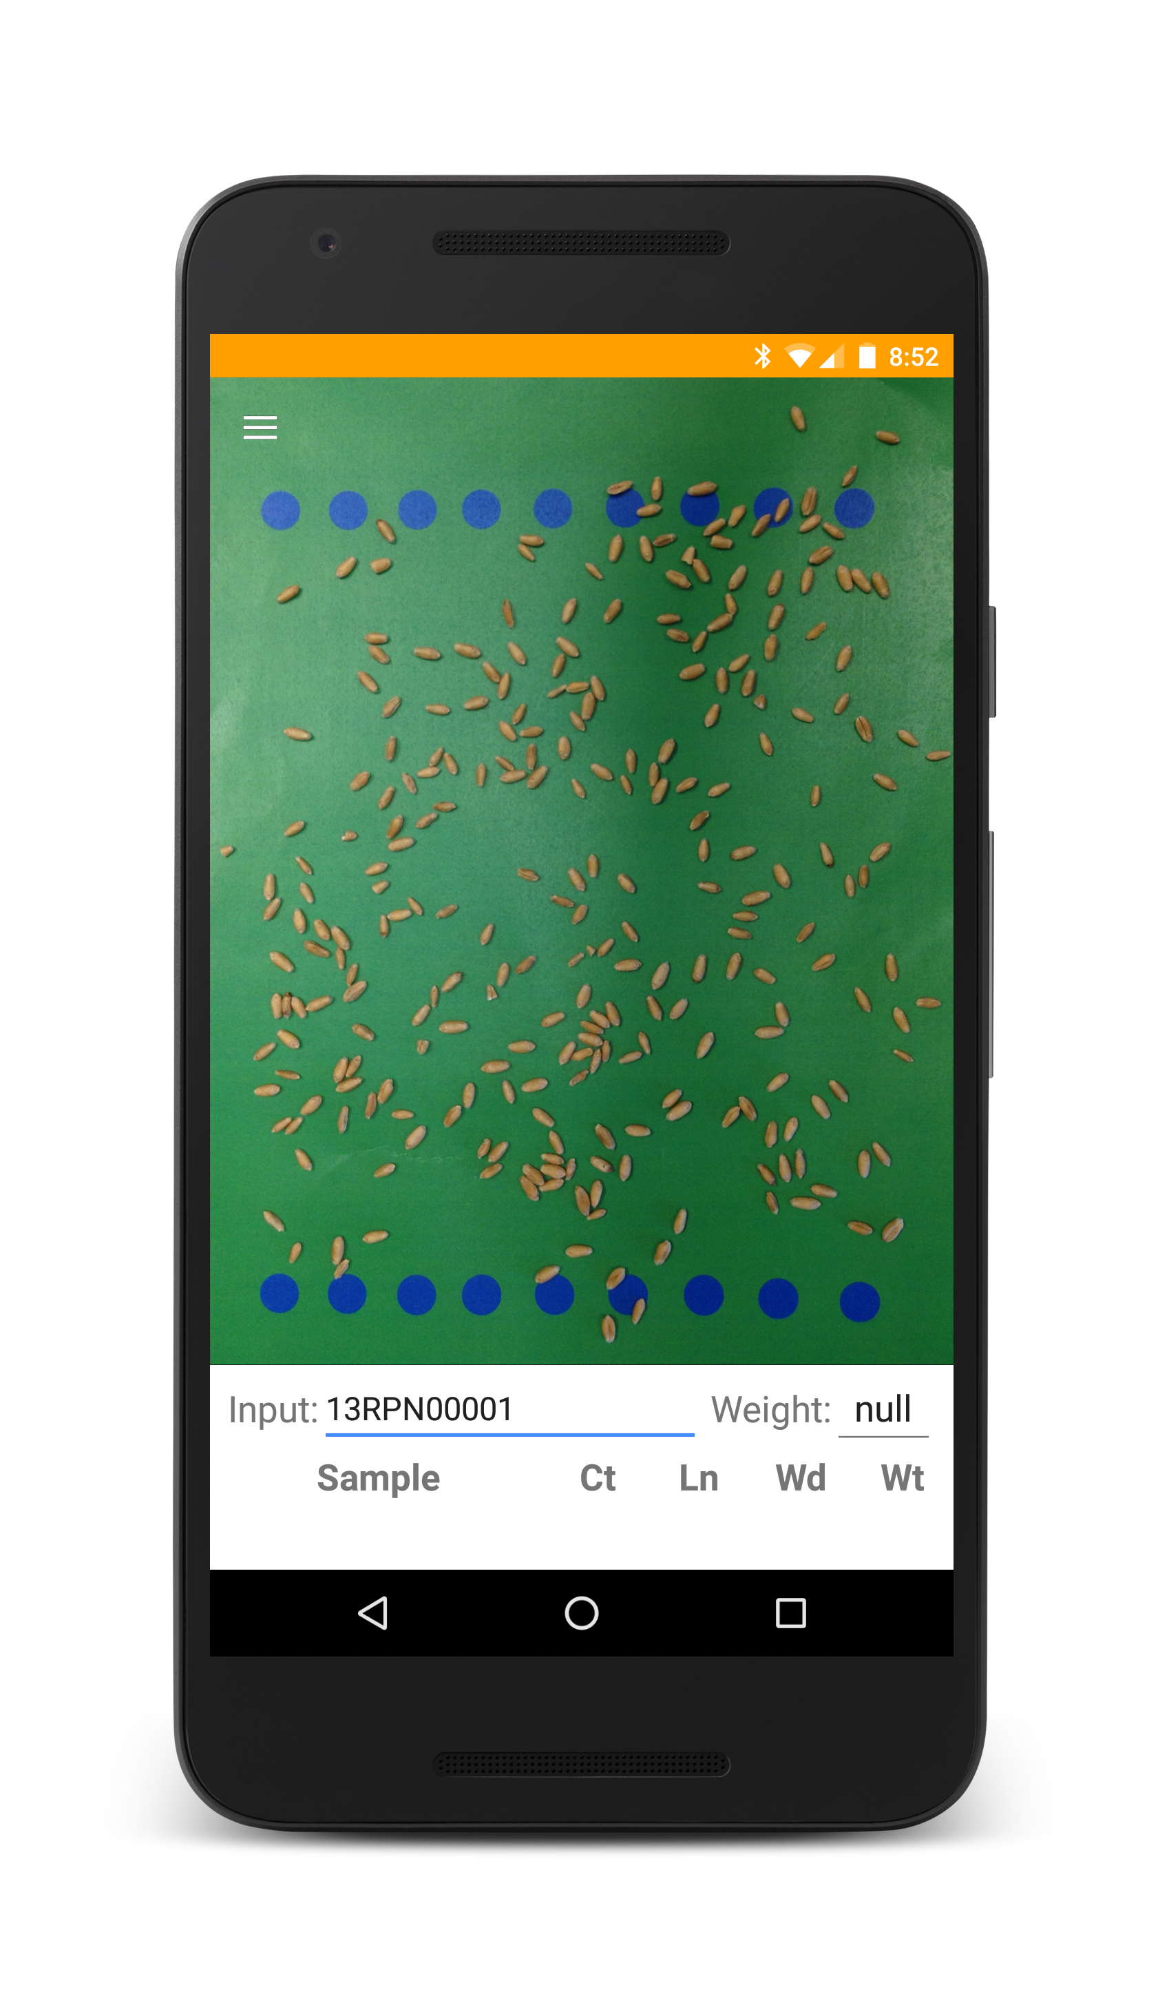
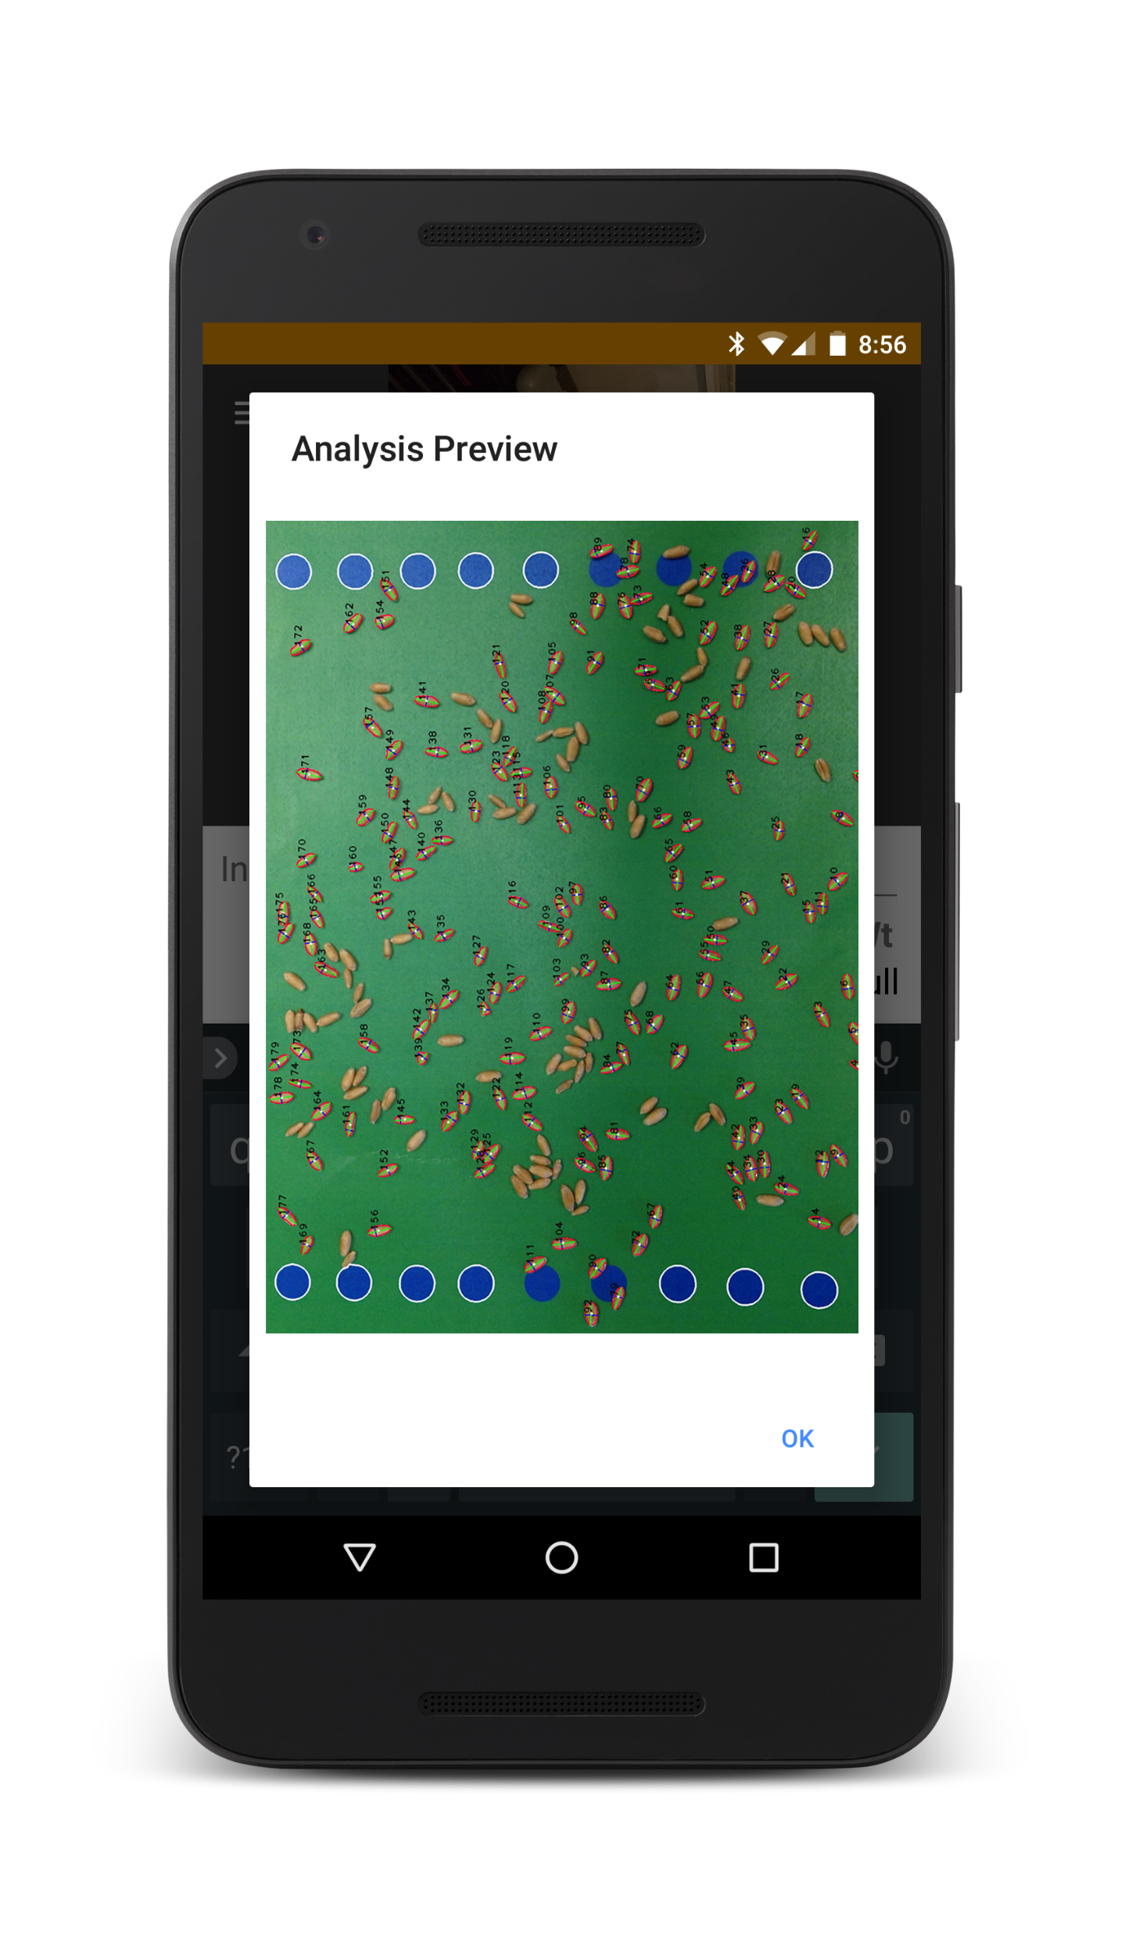
OneKK
One thousand kernel weight
Seed image analysis app
Non-parametric identification
Utilizes SmartGrain algorithm
Two export formats:
Sample summaries
Raw data
In progress

Slide 6
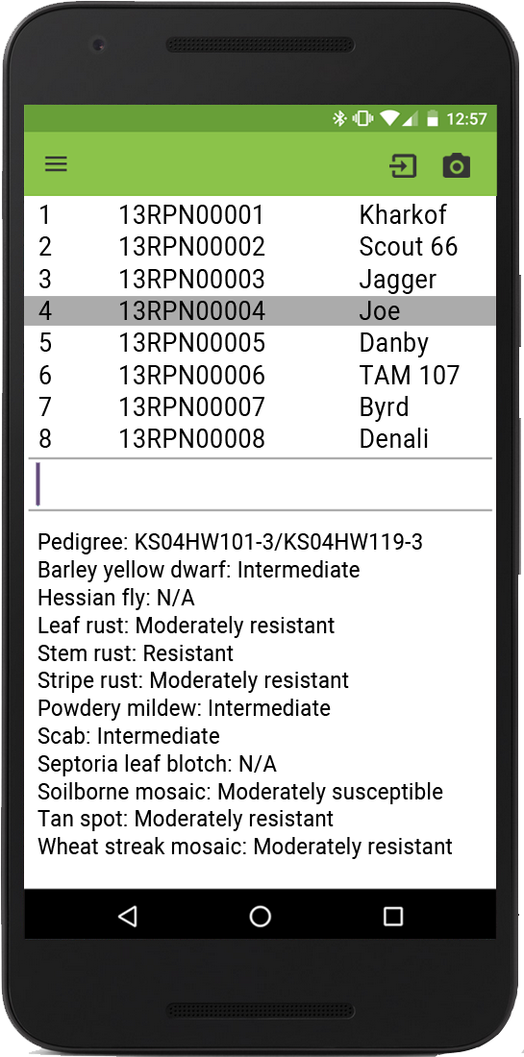
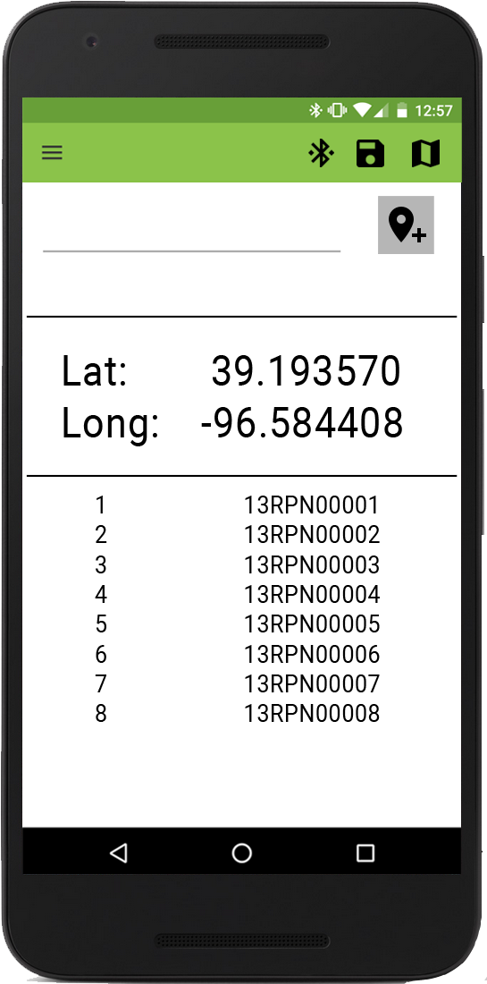
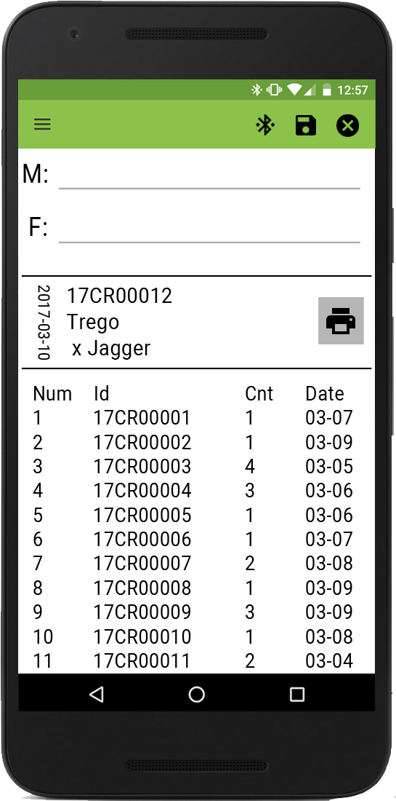
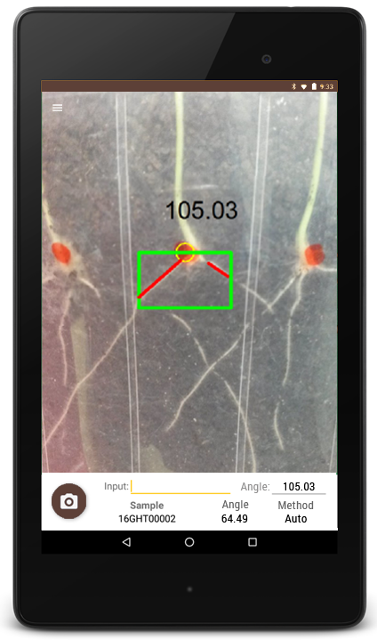




Other Apps
Verify
Survey
Intercross
Rangle

Slide 7

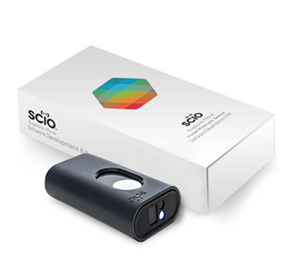
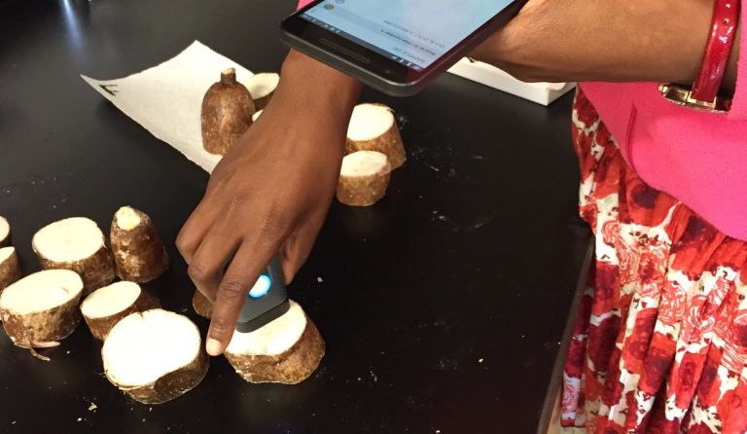
Prospector
Utilize NIRS for dry matter prediction
SCiO
Crowdfunded, portable NIRS
700-1100nm – has shown prediction power on separate device
200x reduction in price
Validating utility by phenotyping via oven method, specific gravity, and SCiO

Slide 8
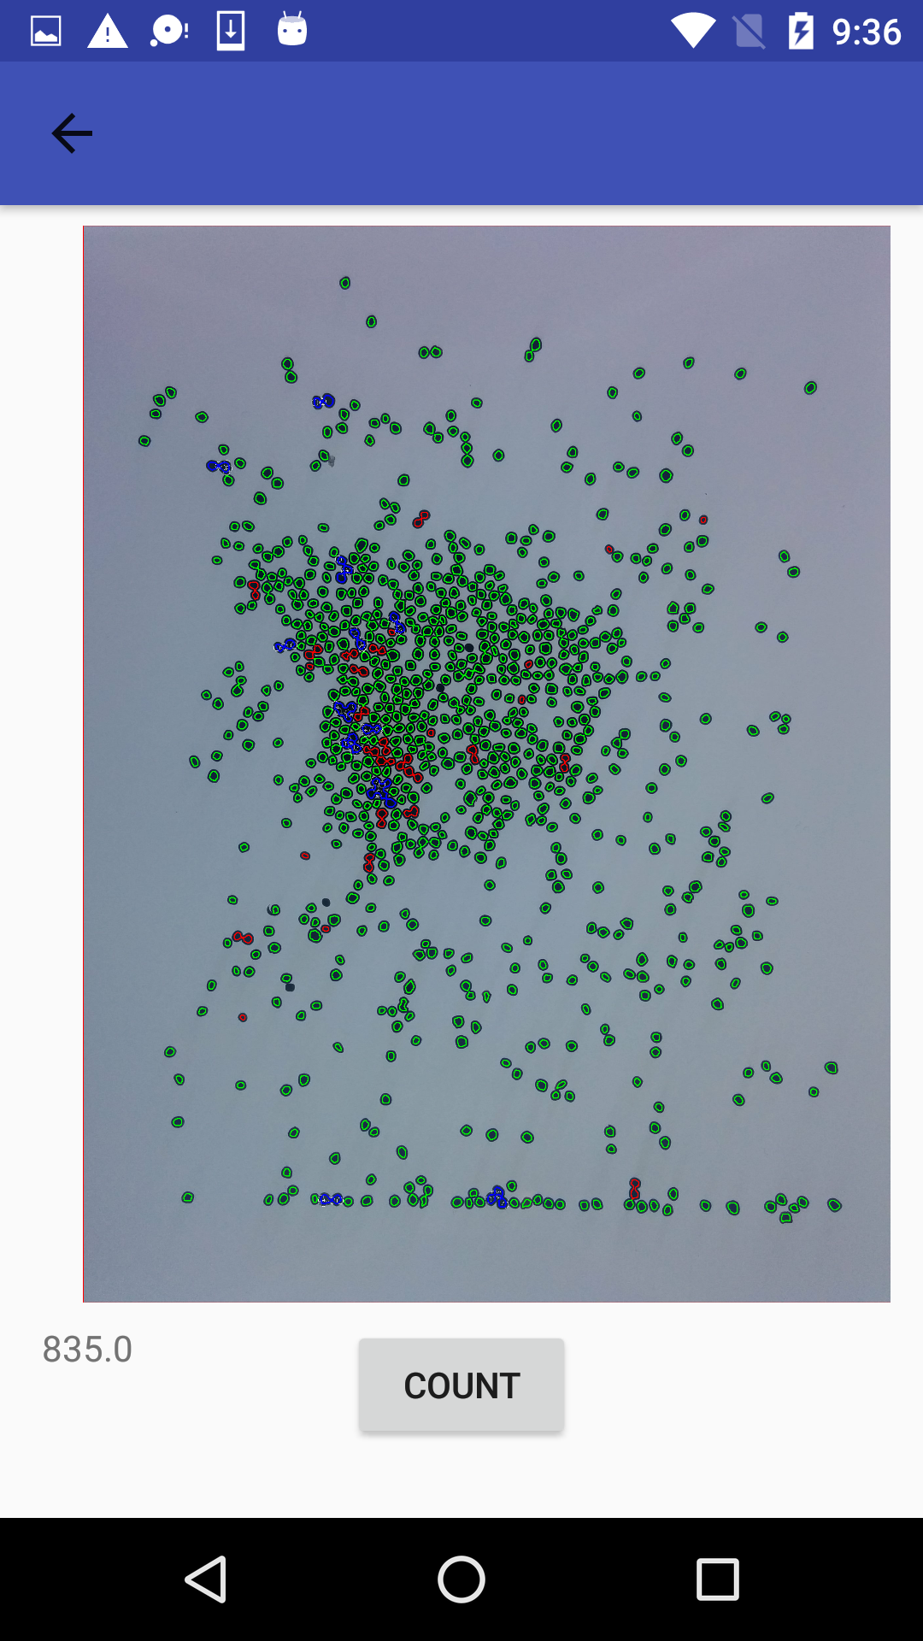
Abacus - Seed Counting
Static counter
single image counter
Dynamic counter
counts seeds in a video

Slide 9

Field Book AR
Communicate with Field Book
Display information as Field Book is updated
Control Field Book via voice
Plot and Trait modes
User can say “Plot” or “Trait” to toggle mode
User can say “Next” or “Back” to control Field Book
Offline voice processing

Slide 10



github.com/PhenoApps
wheatgenetics.org/apps

Slide 11







Acknowledgements

